Slide 1

Operating Systems
CPU scheduling examples

Slide 2
Operating Systems
Formulas used in scheduling
Formulas to compute various time:
1. Waiting Time (WT) of a process = (time when a process enters the cpu for first time – arrival time) + (time of arrival at cpu (from 2nd time onwards) – time when a process left the cpu last)
OR, Waiting time = Turn Around time – Burst time
2. Turnaround Time (TT) of a process = waiting time + burst time
OR, Turn Around time = Exit time – Arrival time
3. Average waiting time = sum of waiting time of N processes / N
4. Average turnaround time = sum of turnaround time of N processes / N

Slide 3
Operating Systems
Example: non preemptive SJF
Process | P1 | P2 | P3 | P4
Arrival Time | 0 | 1 | 2 | 3
Burst Time | 8 | 4 | 9 | 5
Average WT = 7.75
Average TAT = 14.25
Waiting time | 0 | 7 | 15 | 9
Turnaround time | 8 | 11 | 24 | 14
Gantt Chart
P1 | P2 | P4 | P3
0
8
12
17
26

Slide 4
Operating Systems
Example: preemptive SJF(SRTF)
Process | P1 | P2 | P3 | P4
Arrival Time | 0 | 1 | 2 | 3
Burst Time | 8 | 4 | 9 | 5
Average WT = 6.5
Average TAT =13
Waiting time | 9 | 0 | 15 | 2
Turnaround time | 17 | 4 | 24 | 7
Gantt Chart
P1 | P2 | P2 | P2 | P4 | P1 | P3
0
1
2
3
5
10
17
26

Slide 5
Operating Systems
Example: FCFS
Process | P1 | P2 | P3 | P4 | P5
Arrival Time | 0 | 2 | 4 | 6 | 8
Burst Time | 3 | 6 | 4 | 5 | 2
Average WT = 4.6
Average TAT = 8.6
Waiting time | 0 | 1 | 5 | 7 | 10
Turnaround time | 3 | 7 | 9 | 12 | 12
Gantt Chart
P1 | P2 | P3 | P4 | P5
0
3
9
13
18
20

Slide 6
Operating Systems
Example: SJF (non-preemptive)
Process | P1 | P2 | P3 | P4 | P5
Arrival Time | 0 | 2 | 4 | 6 | 8
Burst Time | 3 | 6 | 4 | 5 | 2
Average WT = 3.6
Waiting time | 0 | 1 | 7 | 9 | 1
Turnaround time | 3 | 7 | 11 | 14 | 3
Average TAT = 7.6
Gantt Chart
P1 | P2 | P5 | P3 | P4
0
3
9
11
15
20

Slide 7
Operating Systems
Example: SRTF (preemptive version of SJF)
Process | P1 | P2 | P3 | P4 | P5
Arrival Time | 0 | 2 | 4 | 6 | 8
Burst Time | 3 | 6 | 4 | 5 | 2
Average WT = 3.2
Waiting time | 0 | 1+(10-4) = 7 | 0 | 9 | 0
Turnaround time | 3 | 13 | 4 | 14 | 2
Average TAT = 7.2
Gantt Chart
P1 | P1 | P2 | P3 P3 | P5 | P2 | P4
0
2
3
4
6
8
10
15
20

Slide 8
Operating Systems
Example: RR with q=4 (preemptive FCFS)
Process | P1 | P2 | P3 | P4 | P5
Arrival Time | 0 | 2 | 4 | 6 | 8
Burst Time | 3 | 6 | 4 | 5 | 2
Average WT = 6
Average TAT = 10
Waiting time | 0 | 11 | 3 | 9 | 7
Turnaround time | 3 | 17 | 7 | 14 | 9
Gantt Chart
P1 | P2 | P3 | P4 | P5 | P2 | P4
0
3
7
11
15
17
19
20

Slide 9
Operating Systems
Example: Priority scheduling(non-preemptive)
Process | P1 | P2 | P3 | P4 | P5
Arrival Time | 0 | 0 | 0 | 0 | 0
Burst Time | 10 | 1 | 2 | 1 | 5
Priority | 3 | 1 | 4 | 5 | 2
Waiting time | 6 | 0 | 16 | 18 | 1
Turnaround time | 16 | 1 | 18 | 19 | 6
Average WT = 8.2
Average TAT = 12
Note: A smaller priority number has a higher priority value
Gantt Chart
P2 | P5 | P1 | P3 | P4
0
1
6
16
18
19

Slide 10
Operating Systems
Example1: Priority scheduling(preemptive)
Process | P1 | P2 | P3 | P4
Arrival Time | 0 | 3 | 3 | 5
Burst Time | 6 | 5 | 3 | 5
Priority | 4 | 2 | 6 | 3
Average WT = 8.2
Average TAT = 12
Waiting time | 3 | 11 | 0 | 4
Turnaround time | 9 | 16 | 3 | 9
Note: A larger priority number has a higher priority value
Gantt Chart
P1 | P3 P3 | P1 | P4 | P2
0
3
5
6
9
14
19

Slide 11
Operating Systems
Example2: Priority scheduling(preemptive)
Process | P1 | P2 | P3 | P4 | P5 | P6 | Average
Arrival Time | 0 | 25 | 30 | 60 | 100 | 105
Burst Time | 20 | 25 | 25 | 15 | 10 | 10
Priority | 40 | 30 | 30 | 35 | 5 | 10
Note: A larger priority number has a higher priority value
Waiting time | 0 | 0 | 35 | 0 | 10 | 0 | 7.5
Turnaround time | 20 | 25 | 60 | 15 | 20 | 10 | 25
Gantt Chart
P1 | Idle | P2 P2 | P3 | P4 | P3 | Idle | P5 | P6 | P5
0
20
25
30
50
60
75
90
100
105
115
120

Slide 12
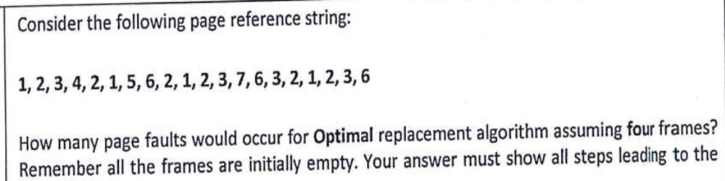
1 2 3 4 2 1 5 6 2 1 2 3 7
6 3 2 1 2 3 6
1
1
2
1
2
3
1
2
3
4
1
2
3
5
1
2
3
6
7
2
3
6
1
2
3
6

Slide 13
FIFO PAGE REPLACEMENT:
REF STRING:1,2,4,2,1,3,2,5,6,7,2,4,2,3,5,6
FRAMES:3
1 2 4 2 1 3 2 5 6 7 2 4 2
3 5 6
1
1
2
1
2
4
3
2
4
3
5
4
3
5
6
7
5
6
7
2
6
7
2
4
3
2
4
3
5
4
3
5
6

Slide 14
Optimal PAGE REPLACEMENT:
REF STRING:1,2,4,2,1,3,2,5,6,7,2,4,2,3,5,6
FRAMES:3
1 2 4 2 1 3 2 5 6 7 2 4 2
3 5 6
1
1
2
1
2
4
3
2
4
5
2
4
6
2
4
7
2
4
3
2
4
3
5
4
3
5
6

Slide 15
LRU PAGE REPLACEMENT:
REF STRING:1,2,3,4,2,1,5,6,2,1,2,3,7,6,3,2,1,2,3,6
FRAMES:3
1 2 3 4 2 1 5 6 2 1 2 3 7
6 3 2 1 2 3 6
1
1
2
1
2
3
4
2
3
4
2
1
5
2
1
5
6
1
5
6
2
1
6
2
1
3
2
7
3
2
7
3
6
2
3
6
2
3
1
2
3
6

Slide 16
OPTIMAL PAGE REPLACEMENT:
REF STRING:1,2,3,4,2,1,5,6,2,1,2,3,7,6,3,2,1,2,3,6
FRAMES:3
1 2 3 4 2 1 5 6 2 1 2 3 7
6 3 2 1 2 3 6
1
1
2
1
2
3
1
2
4
1
2
5
1
2
6
3
2
6
3
7
6
3
2
6
3
2
1
6
2
1

Slide 17
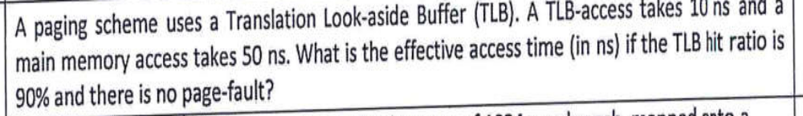
EAT= 0.9x(10+50) + 0.1x(10+50+50)=65ns
If no TLB implemented
EAT=50+50=100ns

Slide 18
Consider a logical address space of 8 pages of 1024 words each, mapped onto a physical memory of 32 frames.
a. How many bits are there in the logical address?
b. How many bits are there in the physical address?
Answer:
a. Logical address: 3+10=13 bits
b. Physical address: 5+10=15bits

Slide 19
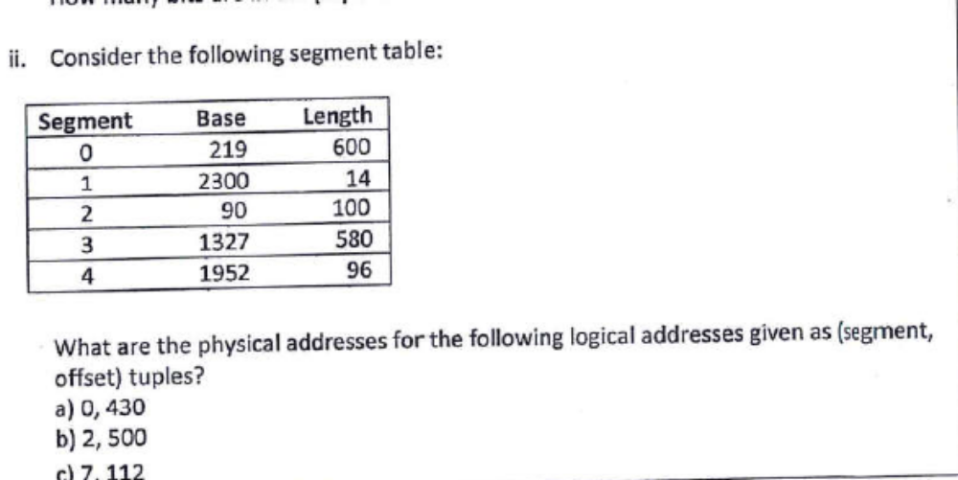

Slide 20
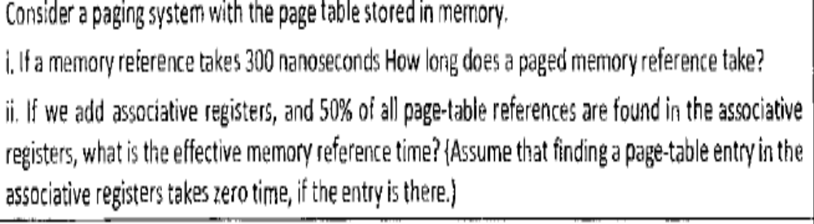
i) EAT= 2x300= 600 ns
ii)EAT=0.5x300+0.5x(2x300)=450ns

